Slide 1

Lecture – 11/29/2016
CSCI 36300 – Software Design

Slide 2
Assignment #4 - Feedback

Slide 3
Composite Pattern

Slide 4
Visitor Pattern

Slide 5
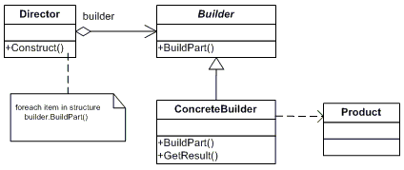
Builder Pattern

Slide 6
Shared Library Discussion

Slide 7
Quiz #15

Slide 8
Principles of Package Architecture

Slide 9
Common Closure Principle
One of the most important principles that I can teach you!
“Classes that change together, belong together.”
It is very challenging to not only compose large scale software systems, but also very hard to test, document, and manage such systems.

Slide 10
Common Closure Principle
How do we make our lives easier?
We group things together that belong together.
Why is this important?
If things that, logically, belong together are composed in such a fashion then it makes it easier to test and to document such similar components.
Changes are minimal to the rest of the system.

Slide 11
Common Reuse Principle
…on the flip side.
“Classes that aren’t reused together should not be grouped together.”
Obviously, based upon the last principle this one should make more sense – let’s keep things separate that should be separate.
Windows OS Example

Slide 12
Principles of Package Architecture
These three principles are mutually exclusive.
Why?
Each benefits a different group – therefore, if we use one another group does not gain from this perceived benefit through its use.
Consequences:
The REP and CRP makes life easy for reusers.
The CCP makes life easier for maintainers.
The CCP strives to make packages as large as possible.
The CRP, however, tries to make packages very small.

Slide 13
Package Coupling Principles

Slide 14
What is Coupling?
Coupling between classes is nothing but dependency of one class on another class.
Coupling is one of the factors to consider in improving a design.
Measures the strength of all relationships between functional units.
Tied closely with cohesion (Low → High).

Slide 15
What is Coupling?
Common forms of coupling are:
Class A has an attribute (data member or instance variable) that refers to a Class B instance, or Class B itself.
Class A has a method which references an instance of Class B, or Class B itself.
These typically include a parameter or local variable of type Class B, or the object returned from a message being an instance of Class B.
Class A is a direct, or indirect, subclass of Class B.
Class B is an interface, and Class A implements that interface.

Slide 16
Package Coupling Principles
Software applications tend to be large systems that contain many different relationships and many different subsequent packages that host the various components.
Focus on the interrelationship between different packages within our software system.
How do we connect, or couple, things together.

Slide 17
Package Coupling Principles
Three Principles:
Acyclic Dependencies Principle
Stable Dependencies Principle
Stable Abstractions Principle
The key is to focus on the communication between the various components.
Don’t force something if it isn’t there.

Slide 18
Acyclic Dependencies Principle

Slide 19
Acyclic Dependencies Principle
Principle Key:
The dependencies between packages must not form cycles.
What does this mean?
We want to minimize the impact that one package has on another such that we could encounter a cyclic dependency.
Let’s look at an example…

Slide 20
Acyclic Dependencies Principle

Slide 21
Acyclic Dependencies Principle
Lets say that I am working on one of the packages in the previous diagram, lets say the Comm Error package.
Now I want to display an error to the user so I need to use the GUI.
In order to use the GUI I create a cycle.
How?
Now I have to test against the entire hierarchy rather than just a subset.

Slide 22
Acyclic Dependencies Principle

Slide 23
Acyclic Dependencies Principle
How do we break this cycle?
We can either create a new package to handle this.
We can use the Dependency Inversion and Interface Segregation Principles to prevent this cycle from occurring.
Let’s take a look at how this might be achieved using a new package…

Slide 24
Acyclic Dependencies Principle

Slide 25
Stable Dependencies Principle

Slide 26
Stable Dependencies Principle
“Depend in the direction of stability.”
What is stability when it comes to software design?
Why is it such a hard concept to grasp and understand?
Standing Penny Example
Is the penny stable – why or why not?

Slide 27
Stable Dependencies Principle
Stability is related to the amount of work required to make a change.
Let’s relate this back to software – how hard is it to change a package?
Size?
Complexity?
Clarity?

Slide 28
Stable Dependencies Principle
We can also force stability by making many other packages depend on one package.

Slide 29
Stable Dependencies Principle
A package with many (inward) dependencies is very stable.
Why?
Because it requires a great deal of work to make changes and deal with all of the dependent packages and their impacts to such change.
How do we measure the stability of a software package?

Slide 30
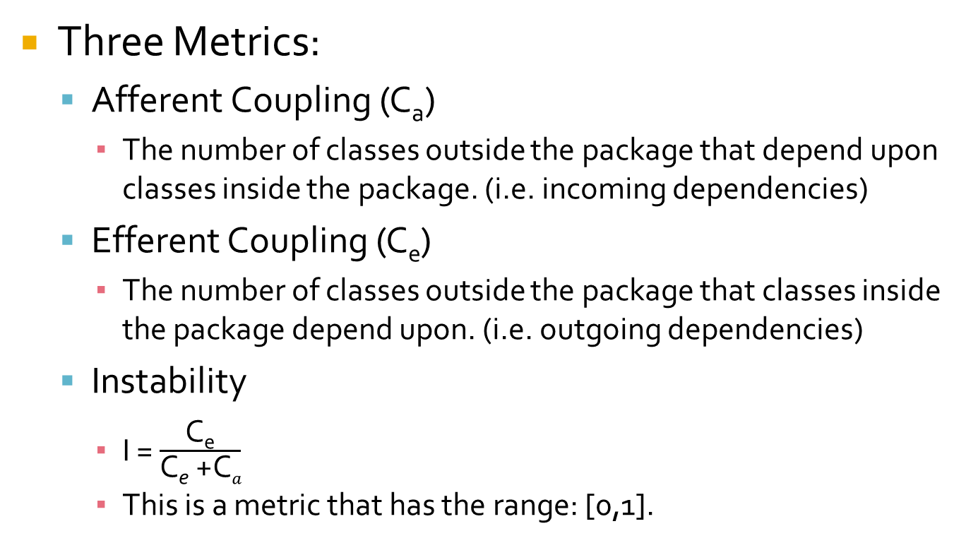
Stable Dependencies Principle
Three Metrics:
Afferent Coupling (C_{a})
The number of classes outside the package that depend upon classes inside the package. (i.e. incoming dependencies)
Efferent Coupling (C_{e})
The number of classes outside the package that classes inside the package depend upon. (i.e. outgoing dependencies)
Instability
I = $\frac{\text{C}\text{e}}{\text{C}\text{e}\text{ +}\text{C}a}$
This is a metric that has the range: [0,1].

Slide 31
Stable Dependencies Principle
Should all software be stable?
Ease of Change
Flexibility & Reuse
Tradeoff:
Stability vs. Flexibility
We want our packages to have this flexibility but we want to prevent those unnecessary and hard to deal with changes from impacting others.

Slide 32
Stable Abstractions Principle

Slide 33
Stable Abstractions Principle
“Stable packages should be abstract packages.”
All dependencies point downward.
Instable at the table – stable at the bottom.
Those at the top are very flexible – those are at the bottom are not.
Is this a desirable situation?
Why/Why Not?
Are there any loopholes?

Slide 34
Stable Abstractions Principle
If we revisit the Open Closed Principle we will see that while they may be difficult to change they do not have to be difficult to extend.
If the packages at the bottom are highly abstract – they can be extended very easily.
Very similar to the Dependency Inversion Principle.

Slide 35
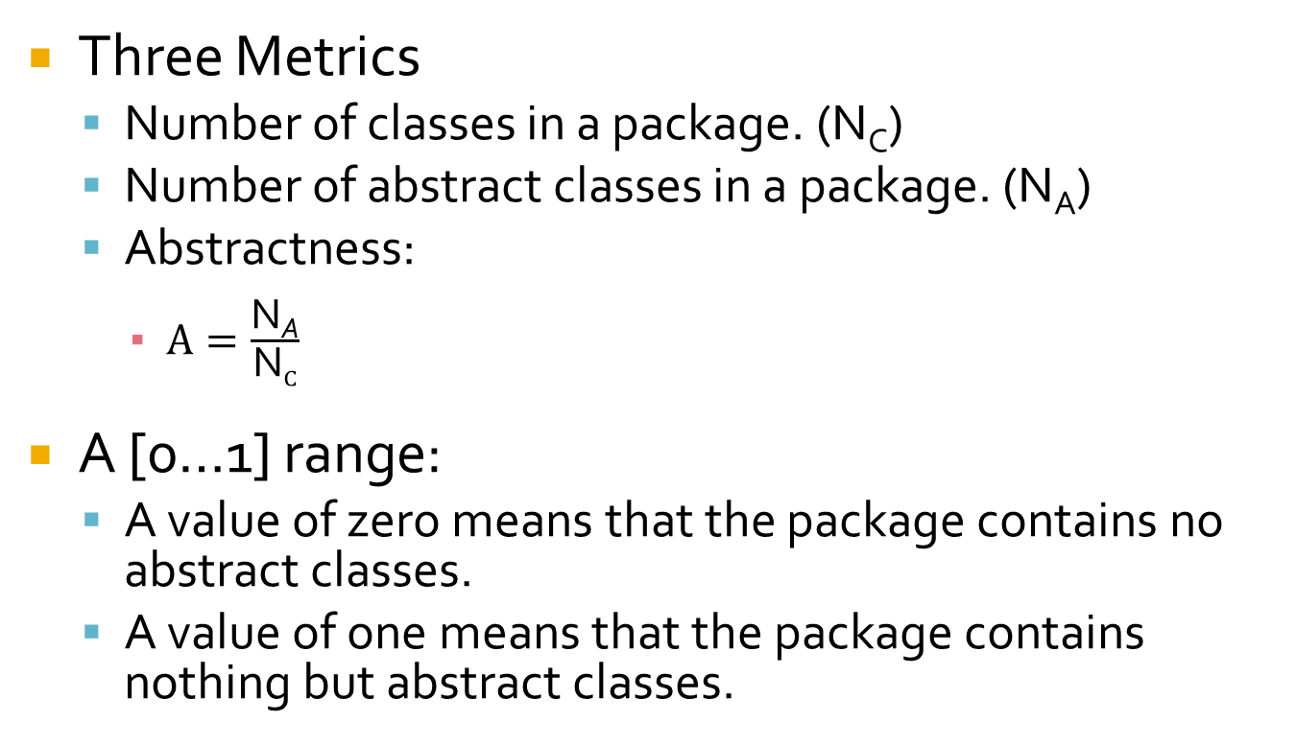
Stable Abstractions Principle
Three Metrics
Number of classes in a package. (N_{C})
Number of abstract classes in a package. (N_{A})
Abstractness:
$A=\frac{\text{N}\text{A}}{\text{N}C}$
A [0…1] range:
A value of zero means that the package contains no abstract classes.
A value of one means that the package contains nothing but abstract classes.

Slide 36
Conclusion
Object-Oriented Architecture & Design
Goals:
Robust
Flexible
Extendable
Etc.
Principles & Patterns
Have been proven over time to be powerful aids in software architecture.

